Slide 1
CS 357 – Numerical Methods 1

Slide 2
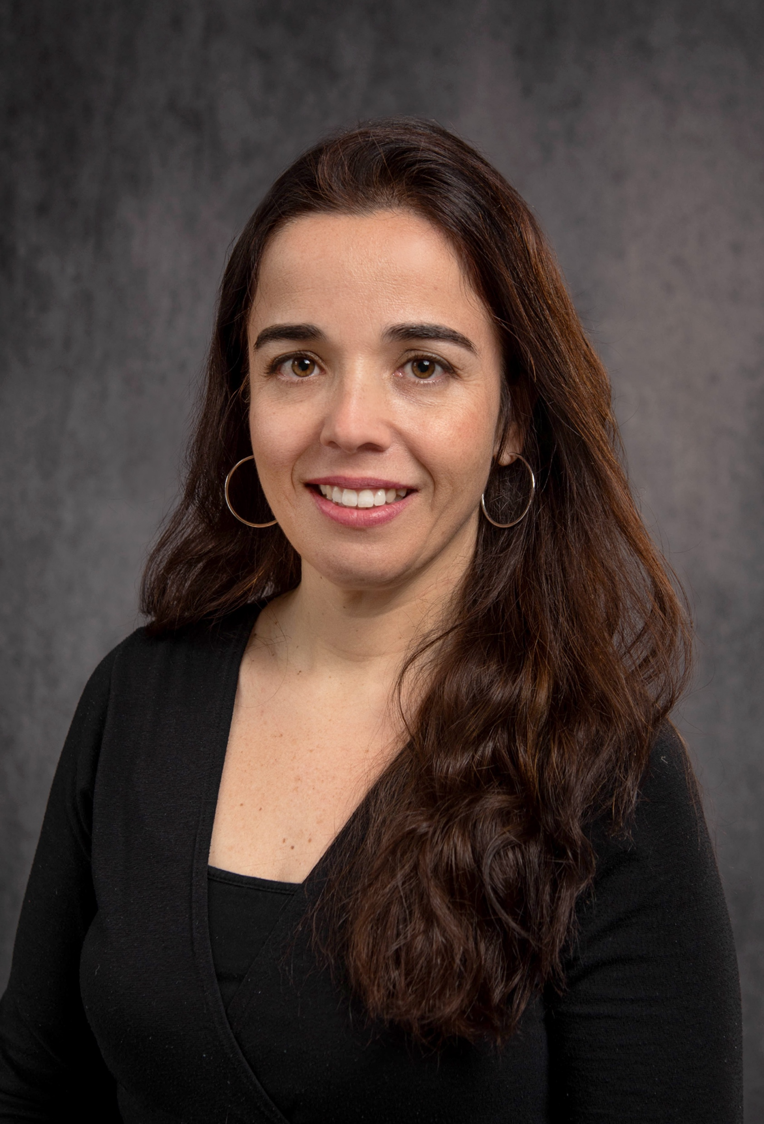
Meeting Mariana
Teaching Associate Professor
https://mfsilva.web.illinois.edu
mfsilva@illinois.edu
Research Area: Computers and Education
Started teaching at UIUC Sp 2012
Taught 10 different courses
Teaching CS 357 since Sp 2018
Co-teaching CS 500 and CS 101 this semester

Slide 3


My professional interests
Computer-based assessments and testing
Fostering collaborations in the classroom
Leveraging Gen-AI for grading, feedback and question generation
Development and adoption of technological innovations for large-scale teaching
Co-founded PrairieLearn Inc in 2021

Slide 4
General announcements
All communication will happen via Discord. NO EMAILS!
Check Discord often (specially the #announcement and #week-ahead channels)
Office Hours: in-person and online options (starts on week 2)
Happy Hours: Siebel 4401 Tuesdays 3-4pm (starts on week 2)

Slide 5
Other important announcements
Our classroom values respect, diversity, and inclusivity. Everyone is welcome here!
Eating is NOT allowed in classroom. You must eat your lunch before/after class (CIF policy!)
There will be Course Surveys and Consent Form for extra credit. Announcements via Discord. First survey on week 3.

Slide 6
Course Website - Syllabus
https://courses.engr.illinois.edu/cs357/pages/syllabus.html

Slide 7
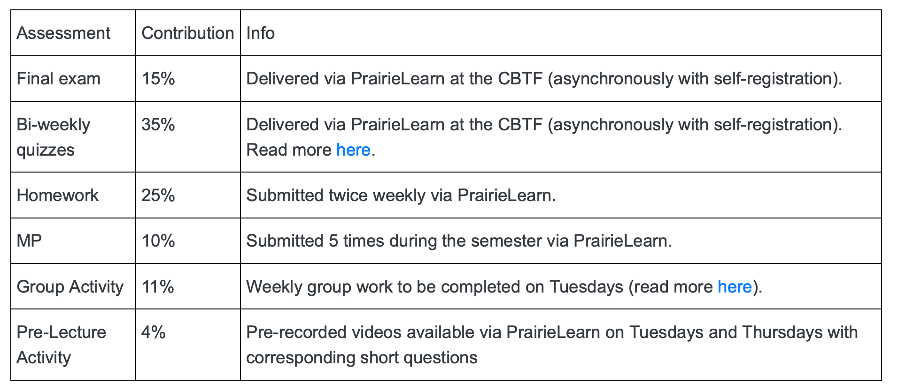
Course Assessments

Slide 8
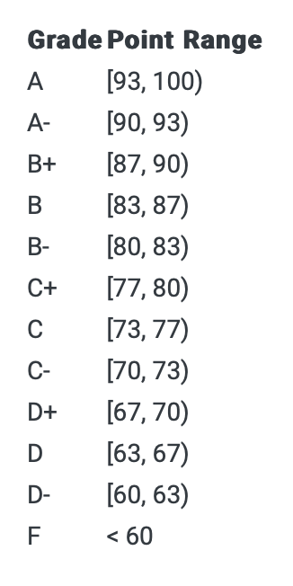
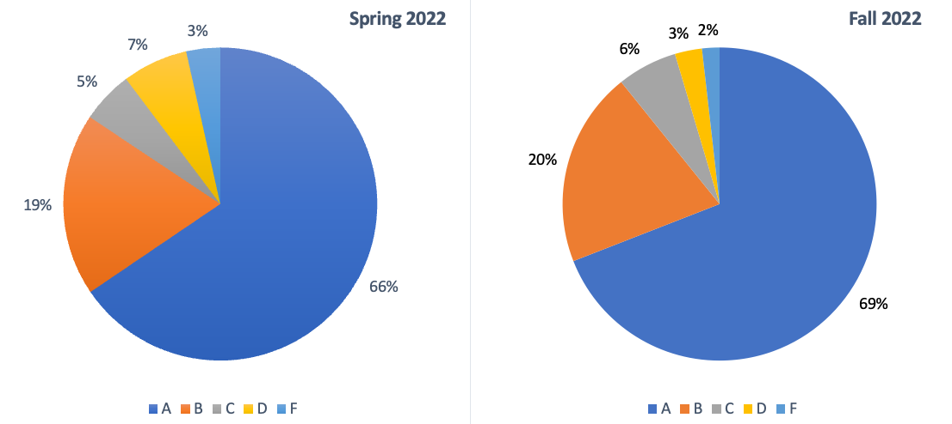
Final Letter Grade Calculation
We never curve
We do not round grades
Up to 1% in extra credit points
A+ given to top 5% students

Slide 9
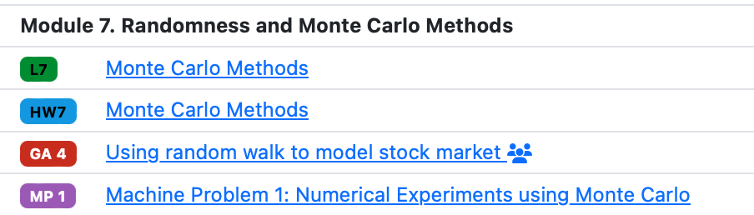
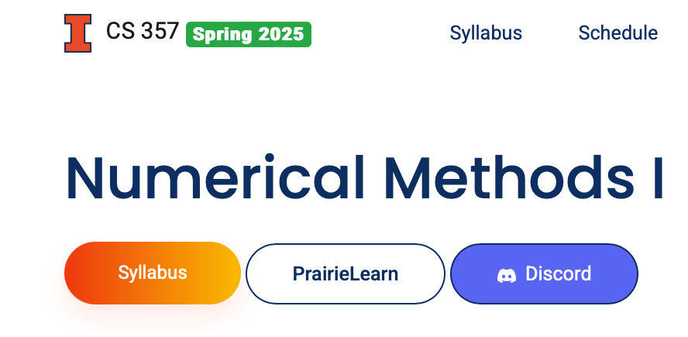
Assessments (all in PrairieLearn)
(Pre-)Lecture
Homework
Group Activity
Machine Problem
Practice Quiz
Let us know if you are not familiar with PrairieLearn and/or PrairieTest. We can give you a demo during office hours, or schedule a separate appointment.

Slide 10
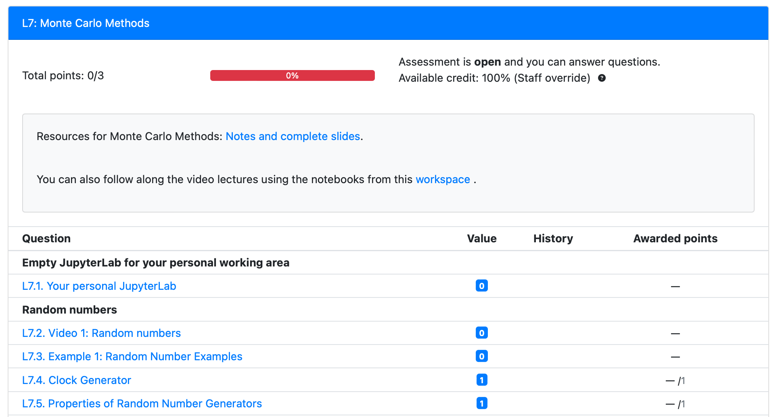
Pre-Lectures
Videos + short check-point questions
Option to read online textbook and/or slides
4 lowest scores will be dropped (4% of final grade)

Slide 11
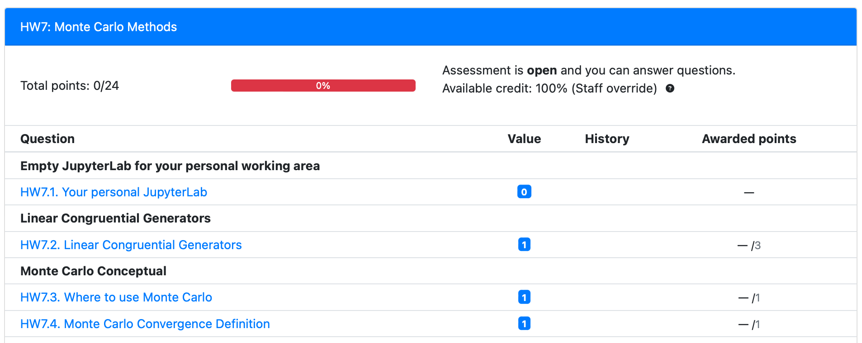
Homework
6-15 questions (MC, checkbox, fill-in-the-blank, coding)
2 lowest scores will be dropped (25% of final grade)

Slide 12
Group Activity (Tuesdays)
Completed on Tuesdays, open from 12:30pm – 1:45pm
Required class attendance for students in Section N (but can still complete the GA until 10pm)
Section M students can complete the GA anytime on Tuesday, from any location. However support is only provided during class time via Zoom.
Mini-introduction (5-10 min): hybrid in-person and Zoom
Lowest score will be dropped (11% of final grade = 9% completion + 2% participation / attendance)
More about GAs next class

Slide 13
Study Hall (Thursdays)
Optional attendance
Only at CIF 35 (no Zoom option), but all students can join
More examples and review
Canceled 6 times during the semester (to compensate for quiz scheduling)

Slide 14
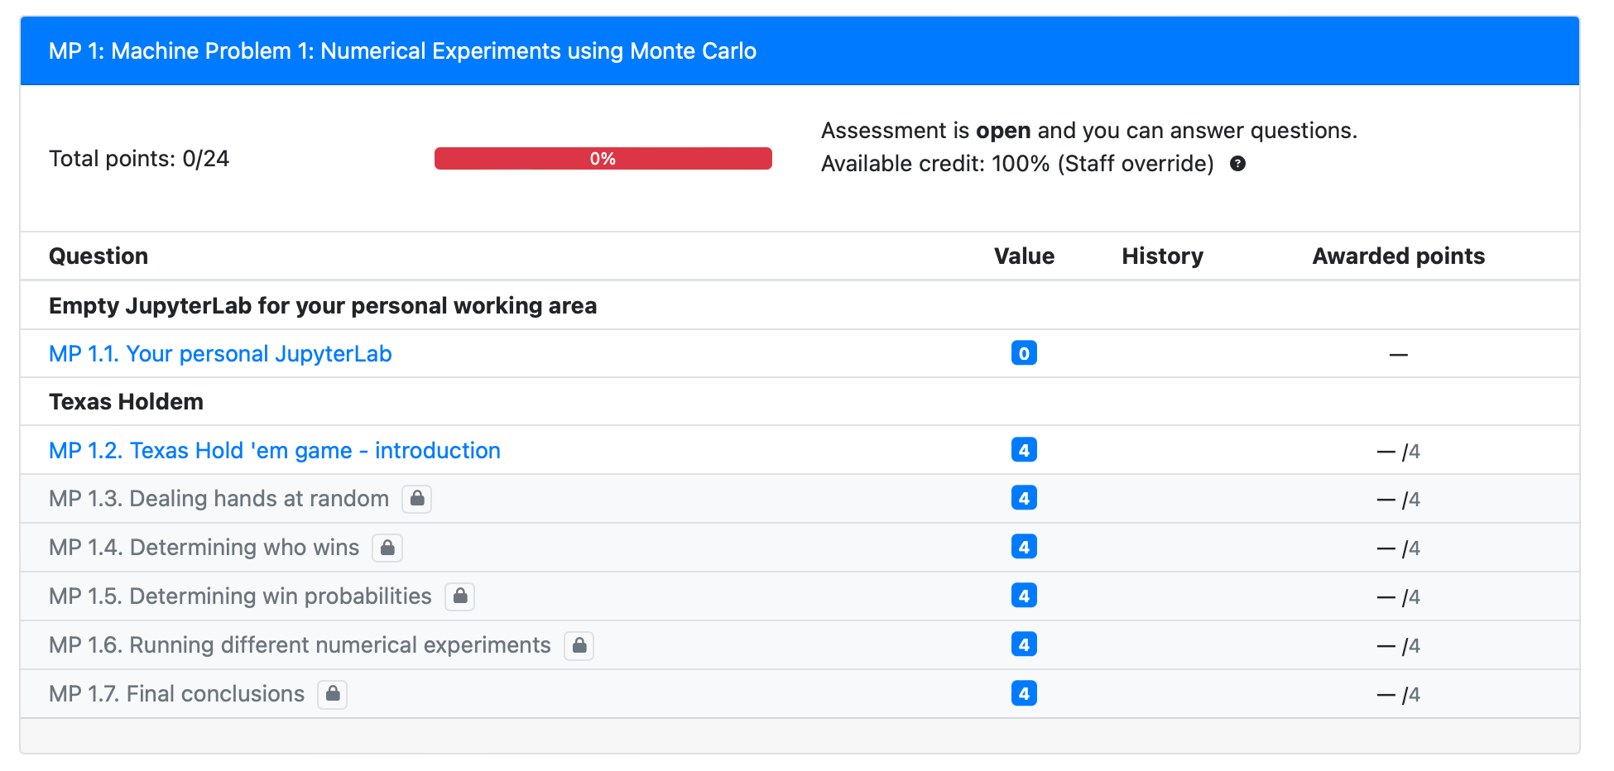
Machine Problems
Longer coding problems
Scaffolded
Appear 5 times in the semester, no drops (10% of final grade)

Slide 15
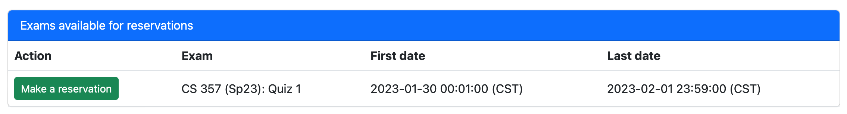
Quizzes
6 quizzes; lowest score is dropped (35% of final grade)
8-12 non-coding questions + 2-3 coding questions
50-min quizzes all at CBTF (check schedule on course website)
DRES students should provide letter to CBTF
We will use PrairieTest to make quiz reservations.
MAKE YOUR RESERVATION AS SOON AS SLOTS OPEN! We will not provide special overrides because you were not able to find a slot that works for you.
Practice Quizzes – generated mostly from the same set of questions that will generate the actual quizzes

Slide 16
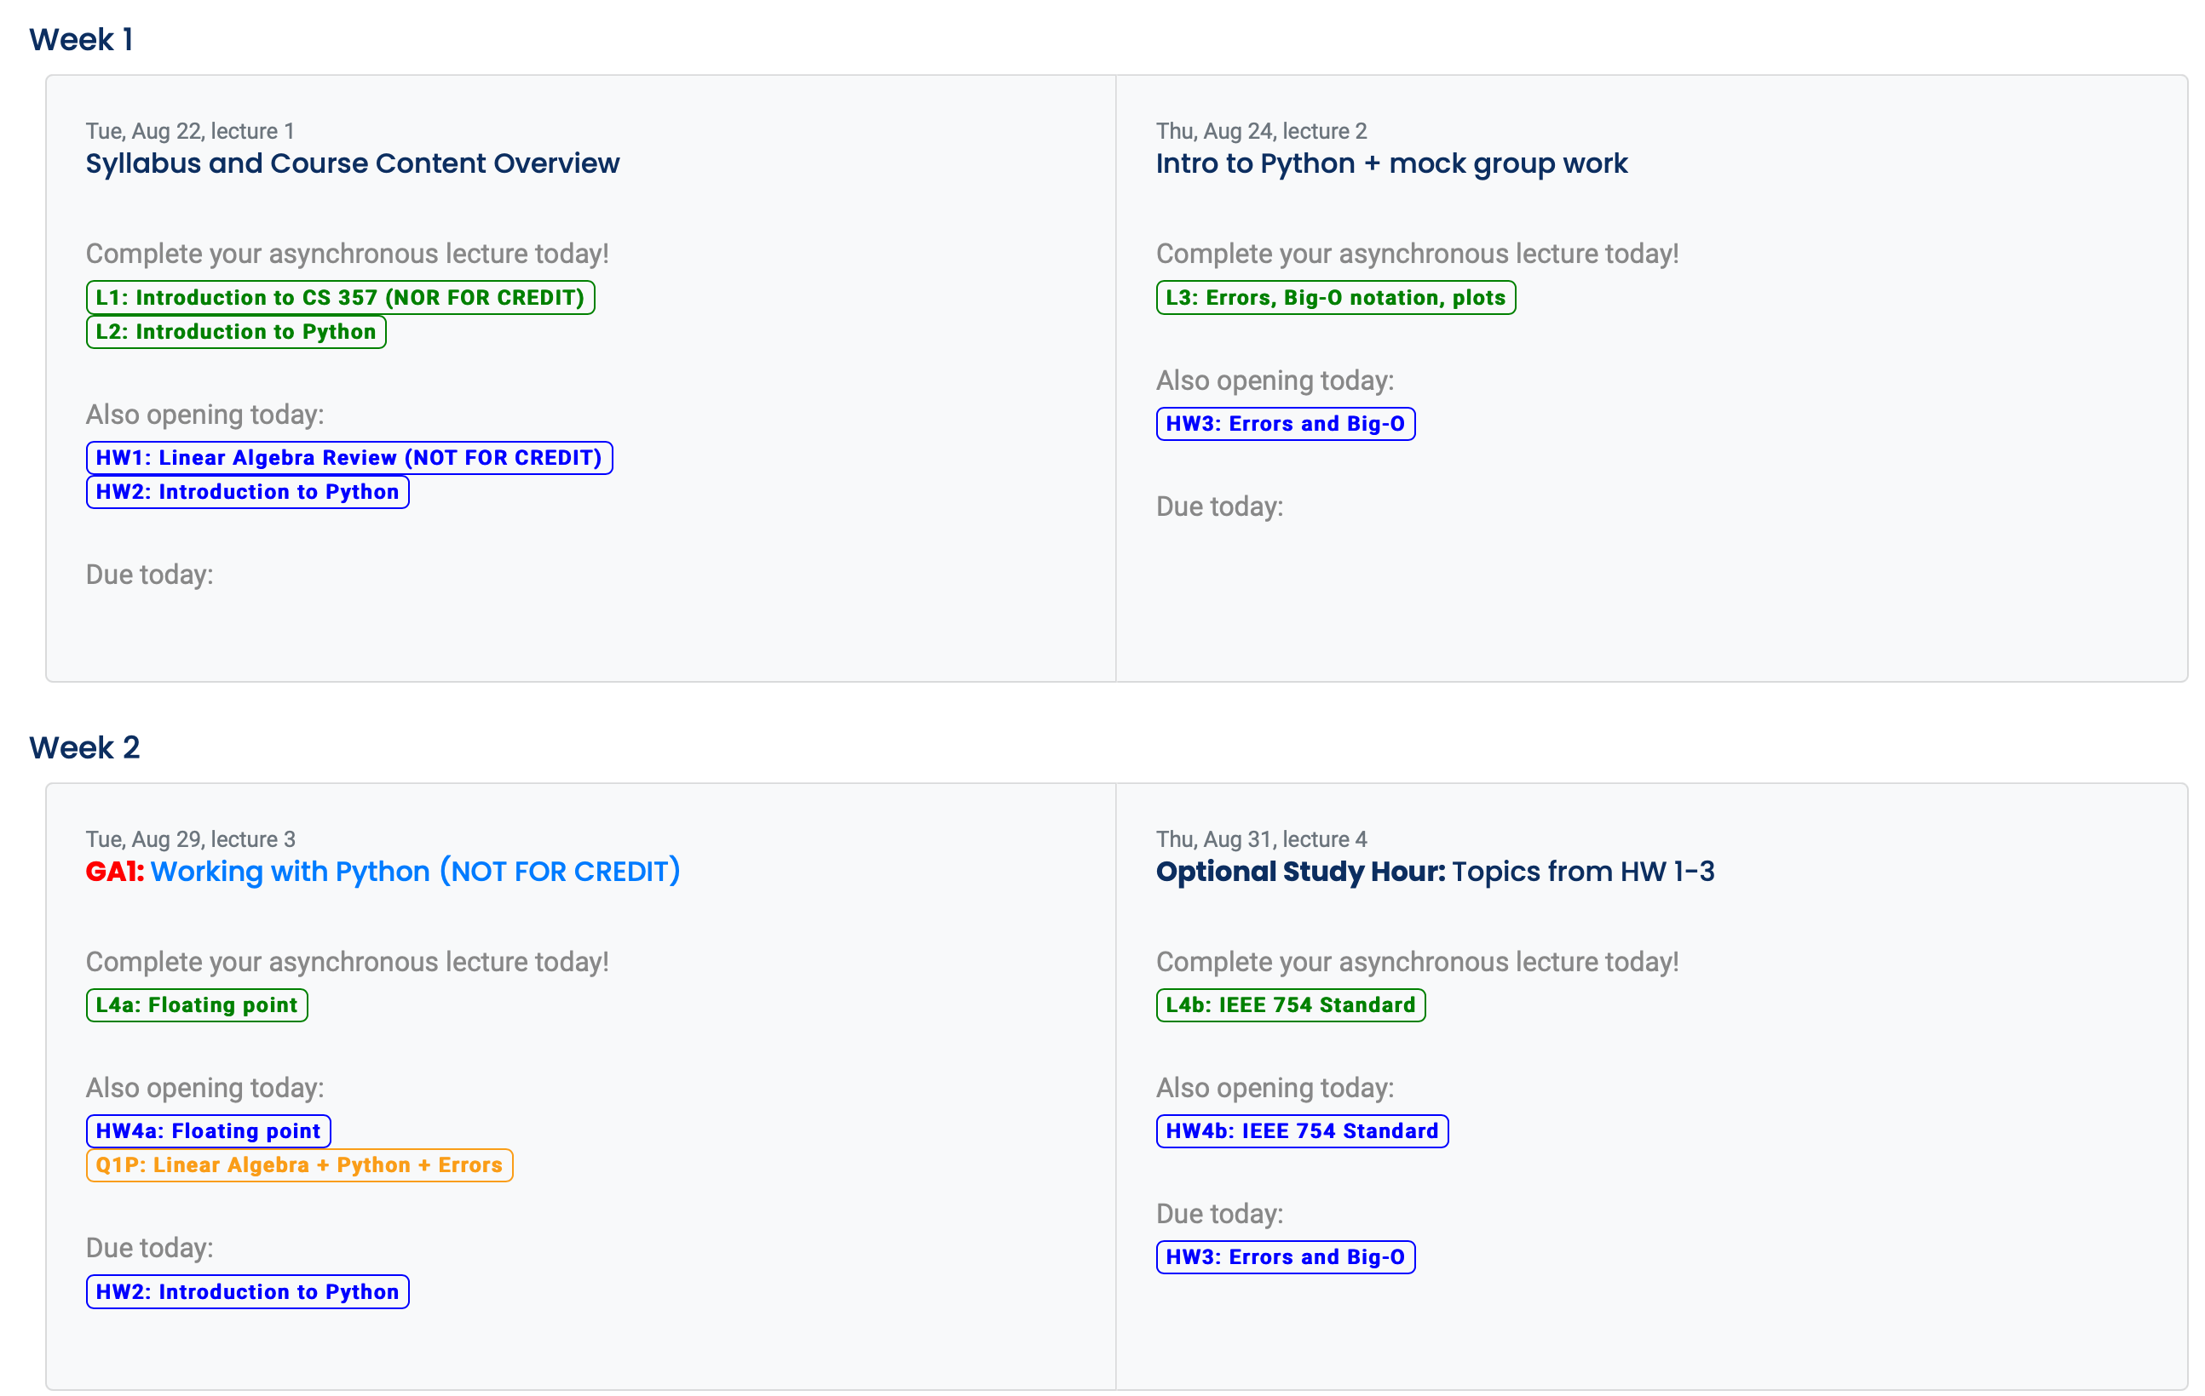
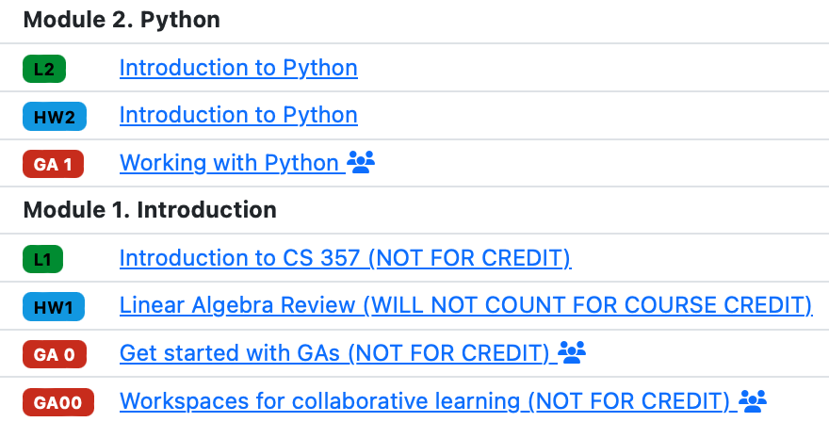
In general lectures and HWs will open at 8am Tuesdays and Thursdays.

Slide 17
Deadlines
96% HW
80% L
LATE DEADLINE
Tuesday
Thursday
Tuesday
Thursday
Tuesday
Thursday
Tuesday
Thursday
L4a
L4b
L5
L6
GA2
GA3
HW4a
HW4b
Quiz 2 period
HW5
HW6

Slide 18
Learning Flow for each Module
Complete lectures on Tuesdays and Thursdays as they open
Get up to 100% credit by completing them before Tuesday 12pm of the week after they open
Get up to 80% credit by completing them before Tuesday midnight of the corresponding quiz week
Get up to 50% credit by completing them before last day of classes
Complete the Homework
Get up to 100% credit by completing them within one week after they open
Get up to 96% credit by completing them before Tuesday midnight of the corresponding quiz week
Get up to 50% credit by completing them before last day of classes
Complete MPs (when available) – similar deadline scheme as HW
Practice Quizzes
You are encouraged to start the practice quizzes only after you complete the learning flow above
Complete at least one entire practice quiz as if you were taking the quiz (no access to resources, timed, etc). This will give you a good idea of how ready you are.

Slide 19
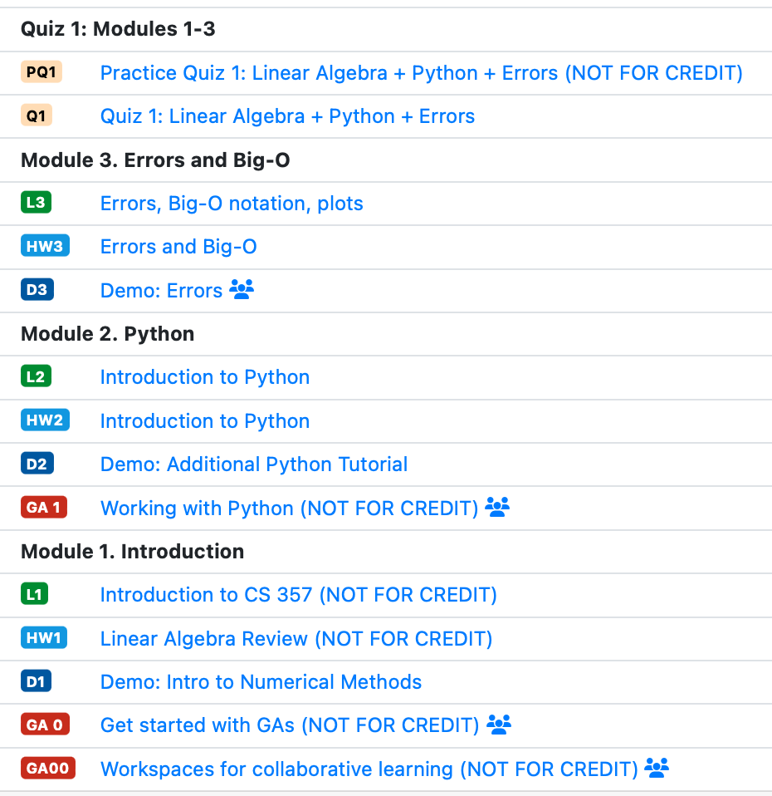

Slide 20
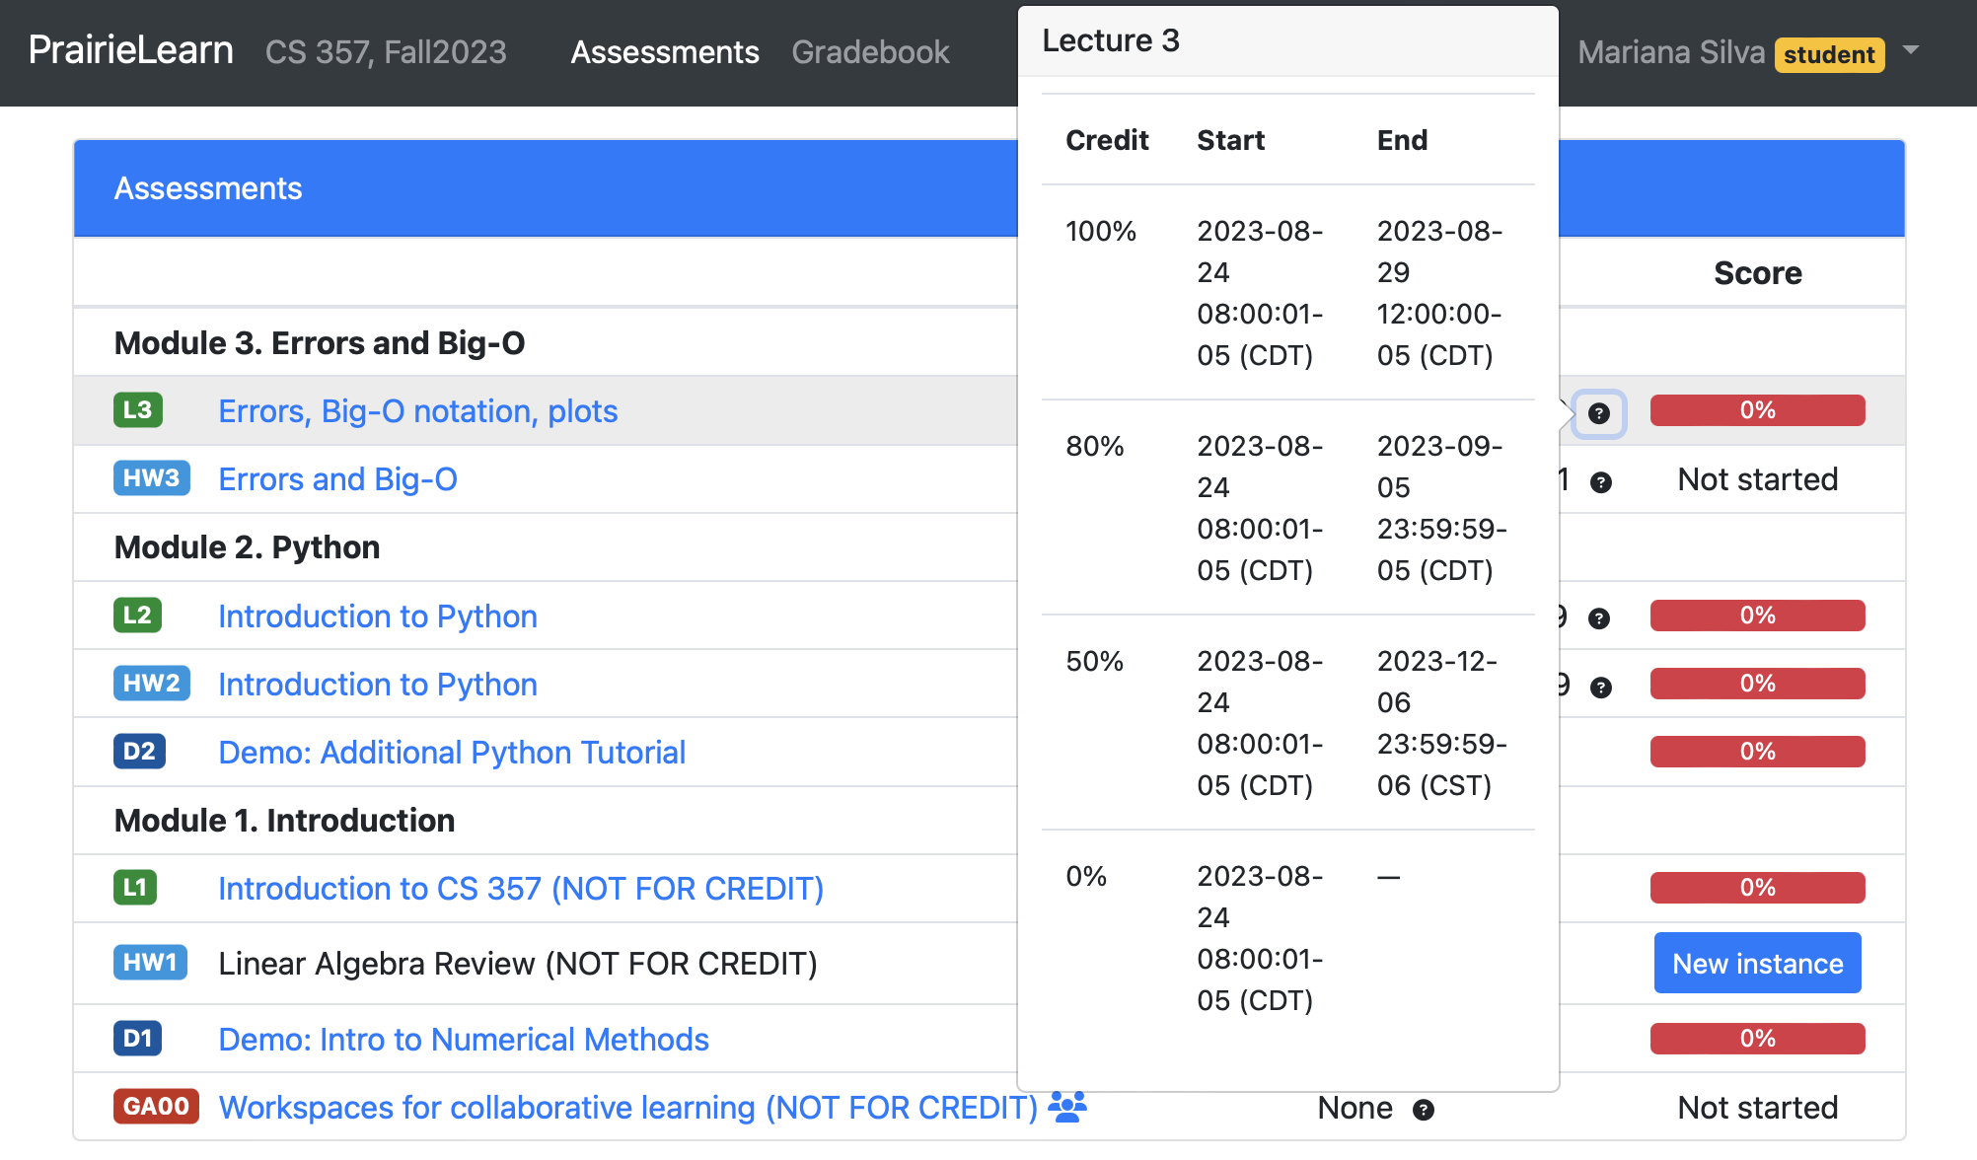

Slide 21
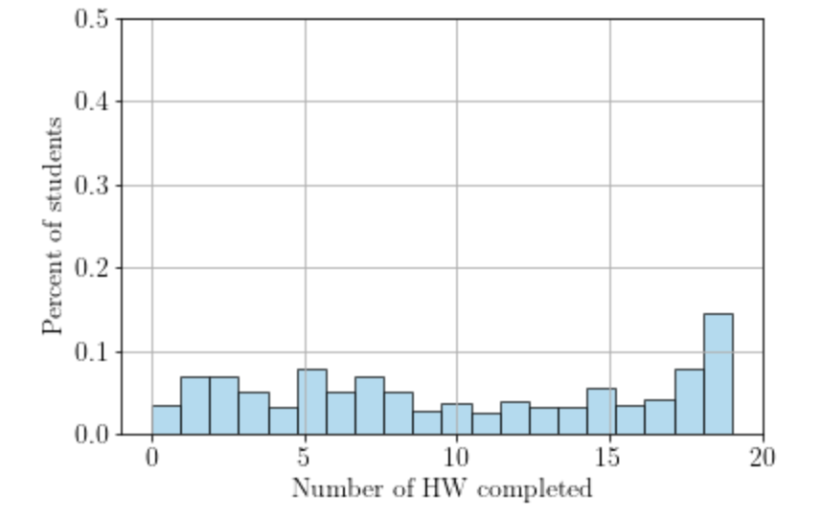
What did we learn about flexible deadlines in this class?
With “hard” one-week deadlines
With flexible deadlines
~80%
25%
Percent of students who complete most of the HW
decreased from ~80% to ~25%!
Zhao, West, Silva. (submitted to ASEE, 2023 )

Slide 22
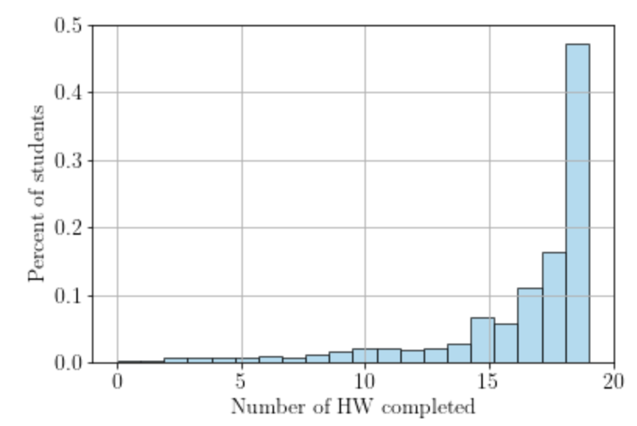
What did we learn about flexible deadlines in this class?
With flexible deadlines
Completion by 100% deadline
Completion by 96% deadline
71%
25%
Percent of students who complete most of the HW
Increased to 71% by the quiz date
Zhao, West, Silva. (submitted to ASEE, 2023 )

Slide 23
How HW completion impact quiz performance
Regression model to fit exam scores including control for GPA
Baseline: students who did not complete HWs by the exam date
Baseline students = 29%
Students who complete HWs … | average score advantage on exams | % students
Do not complete | 0% (baseline) | 29%
by exam date | 14.4% | 46%
within one week | 18.6% | 25%

Slide 24
What do we know about online vs in-person sections in CS 357?
In-person and Online students have similar performance on all “learning” assignments
In-person students have ON AVERAGE a small (2.4%) score advantage on quizzes when compared to online students
Notes:
In-person students have on average
2.4% score advantage on quizzes
1.2% score advantage on final course grade ($p=0.067$)
when compared to online students
(after controlling for GPA)

Slide 25
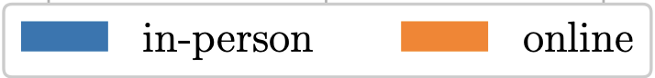
Strongly
agree
Sense of Belonging
Survey questions regarding perceived comfort, support, and isolation
Increased SoB over the semester
In-person students report higher increase in SoB when compared to online students
Online section: not significant increase in SoB for men; significant increase in SoB for women
Disaggregated by Gender
Increased belonging
F
M
F
M
Strongly
disagree
Regarding other CS courses
Regarding current CS course

Slide 26
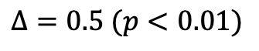
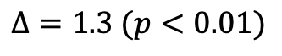
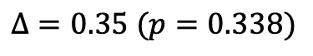
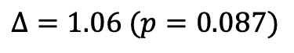
URM only
First-Generation only
$$Δ=1.06 (p=0.087)$$
$$Δ=1.3 (p<0.01)$$
$$Δ=0.35 (p=0.338)$$
$$Δ=0.5 (p<0.01)$$
Regarding other CS courses
Regarding current CS course
Regarding current CS course
Regarding other CS courses

Slide 27
Students select the section that best fit their preferences

Slide 28
Introduction and “Big Idea”

Slide 29


Numerical Methods ?
What are…
Numbers in a computer
(and how computer understands these numbers)
Mathematical model
“algorithms” derived from math ideas to solve equations numerically
Complexity of the problem
Slow vs fast
Accuracy
Accurate vs inaccurate
Method = Math + Complexity + Accuracy
Notes:
How can a method that described an exact math problem can be inaccurate? We need to know how to deal with such introduced errors.

Slide 30
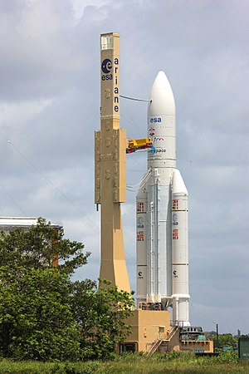
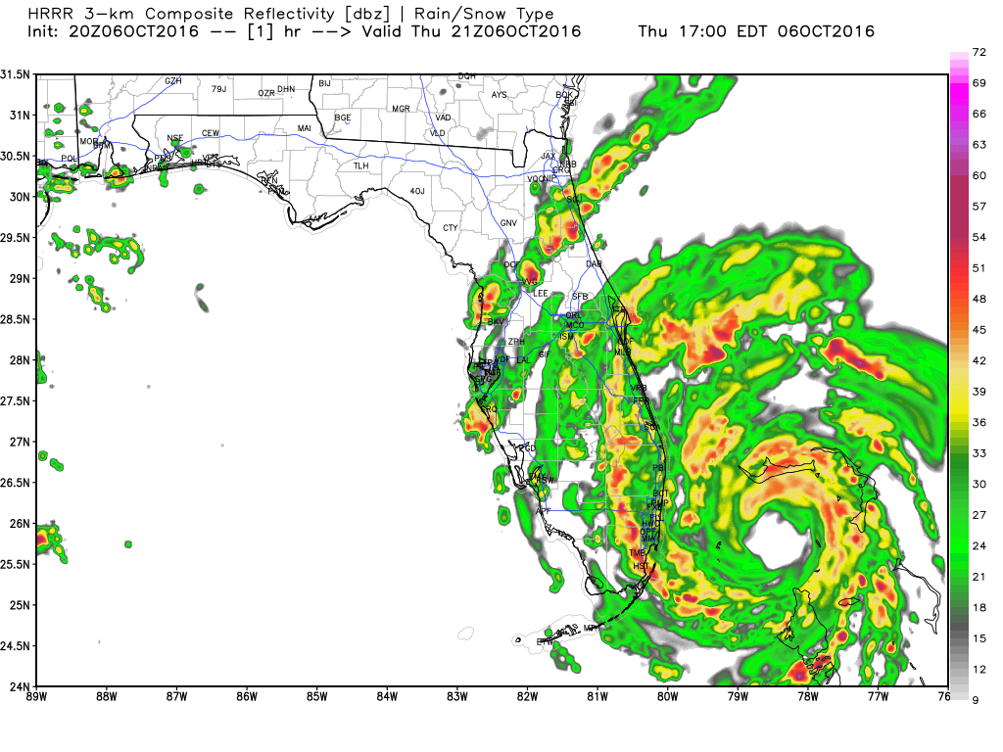
Why is this course important?
Understanding and reconstruction of known problems
Natural disasters
Catastrophic failures
Prediction of unknown situations
Weather conditions
Behavior of new materials
Optimization of existing problems
Image recognition
Reduce fabrication costs
Explosion of Ariane 5 in 1996
Notes:
Ariane-5-explosion: Self-destruction was caused by a data type conversion and therefore incorrect representation of real numbers

Slide 31
Goals for this course
Understand how numbers are represented in the computer.
When developing code, you will likely run into numerical errors. What are the sources of these errors?
How can you avoid numerical errors?
How can you choose a suitable algorithm for a given application?
Use existing libraries to solve real applications.

Slide 32
(Numerical) Method = Math + Complexity + Accuracy
Mathematical model:
What equations can we use to represent our problem?
Accuracy:
Are we getting accurate results?
Why is the method not giving me the correct solution?
Complexity:
How long does it take to solve this problem?
Is it cost-effective?

Slide 33
Your entire CS 357 semester in a few slides!
Are you ready?

Slide 34
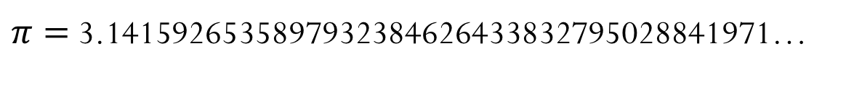
Accuracy
Why a numerical method might not give the right answer?
Computers have finite representation of numbers
Sometimes the “right answer” cannot be represented in a finite way
Example:
$π=$3.1415926535897932384626433832795028841971…

Slide 35
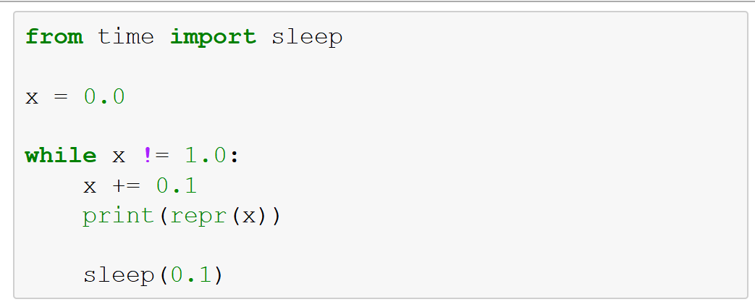
Demo: Waiting for the number 1
What is going to happen when we run this code?
Code will stop after printing 11 values for x
Code will stop after printing 10 values for x
Code will not stop
Code will not start

Slide 36
Monte Carlo Methods
Texas Holdem Game: we would like to determine the probability of winning of a given starting hand
Physical experiment
vs
Numerical experiment

Slide 37
Numerical Experiments
What do we want to know about a numerical experiment?
What questions are we attempting to answer?
What is the outcome of the experiment?
Is it repeatable?
Is the answer accurate?
How long will it take?
Time vs accuracy trade-off
Question: Is running this method (with a certain accuracy) a good use of our time and/or computer resources?
Notes:
Demo Brownian motion: model the little particles and their collisions, and we can model the motion of the large particle as random, and the particles bump in x and y in an uniform way.
10 thousands random things that bump into each other.

Slide 38
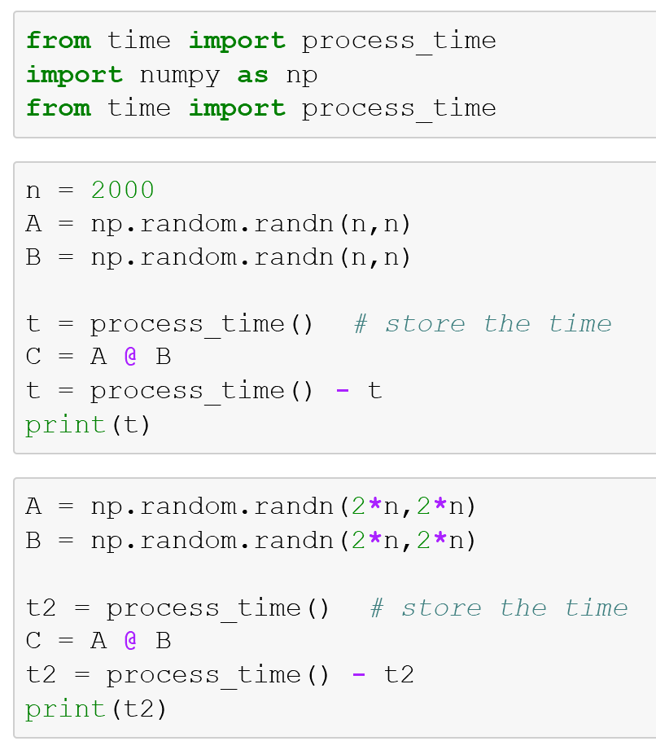
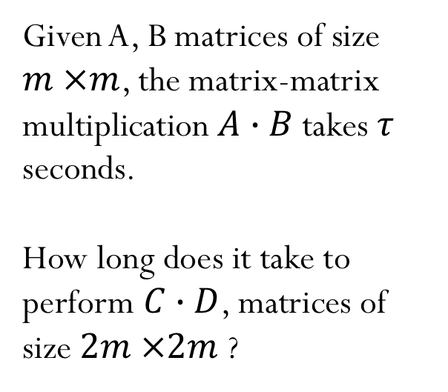
Complexity
How long does it take to solve a problem?
Given A, B matrices of size $m ×m$, the matrix-matrix multiplication $A∙B$takes $τ$ seconds.
How long does it take to perform $C∙D$, matrices of size $2m ×2m$ ?
Notes:
Write with approximate notation. Double the problem size, the time to solve a matrix-matrix multiplication grows by a factor of 8.
Students don’t get the same time. Even after running twice for the same computer, the time is not the same. The result depends on the state of the system and

Slide 39
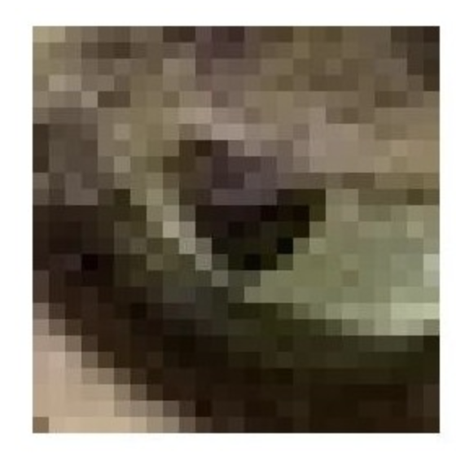
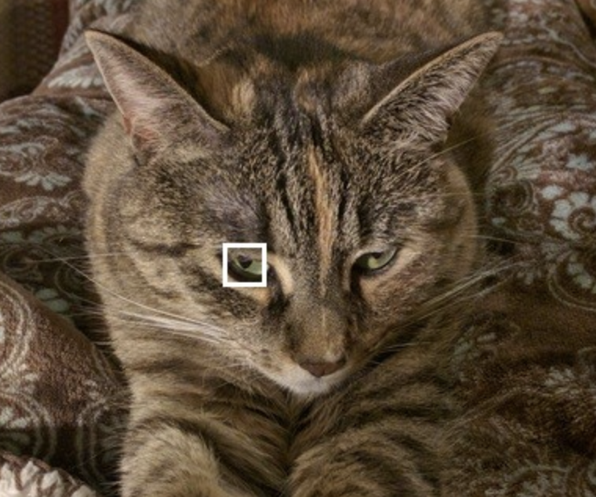
Linear system of equations: Image processing
How can we use linear operators to create blurred images? How can we do the inverse process?
Image credit: https://datacarpentry.org/image-processing/

Slide 40
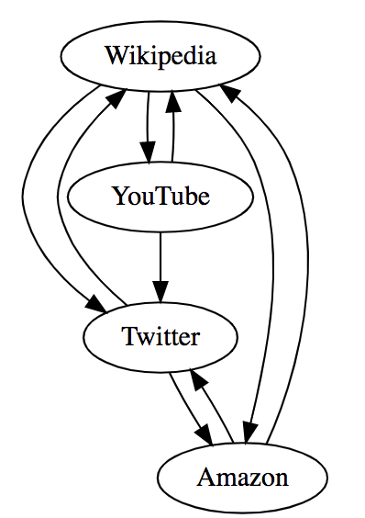
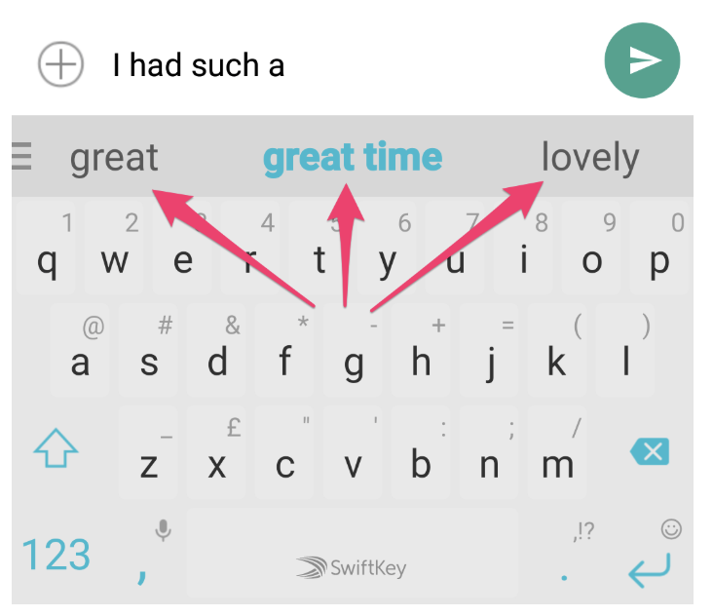
Markov chain
Page Rank
Word prediction

Slide 41
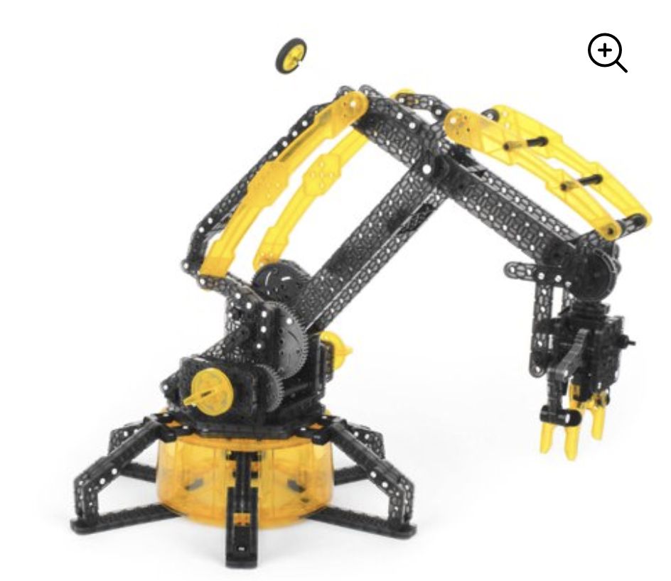

Nonlinear system of equations
Inverse kinematics: find the angles that make the robotic hand grab a chocolate candy!

Slide 42

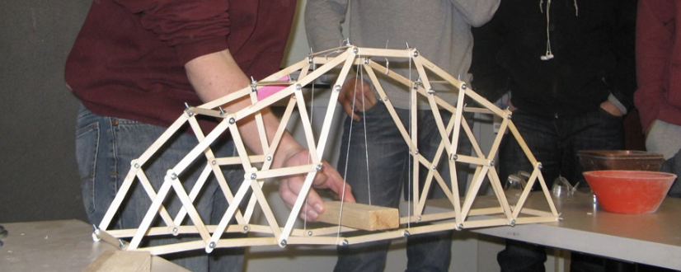
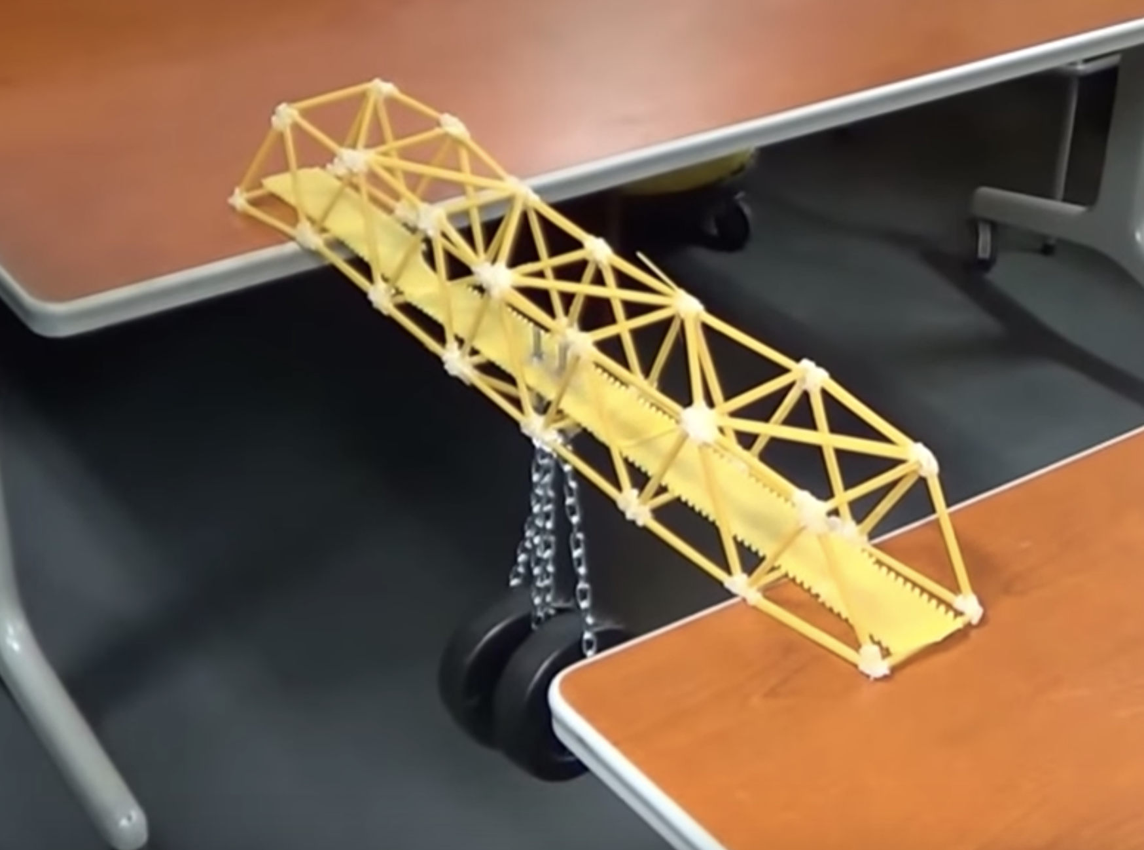
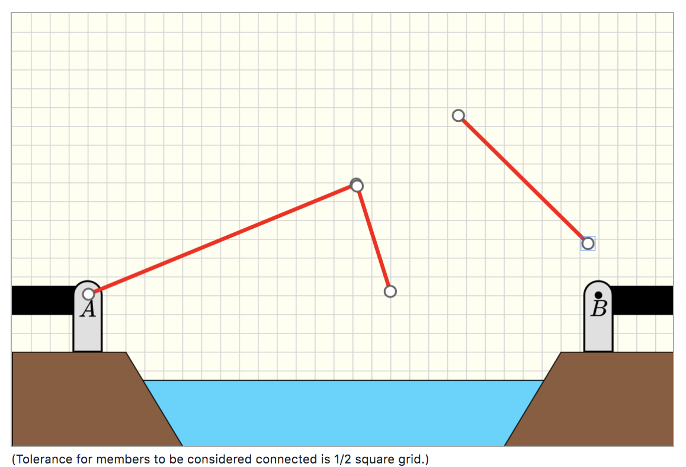
Optimization
Numerical simulations to find optimized bridge designs
Bridge design (high school projects)
http://cs357-stu-01.cs.illinois.edu/

Slide 43
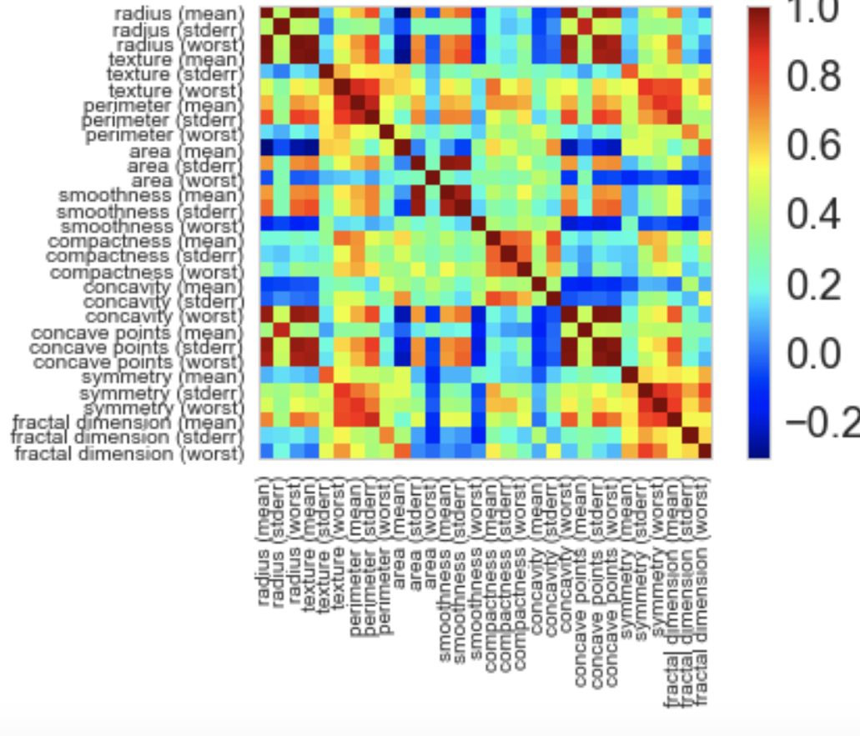
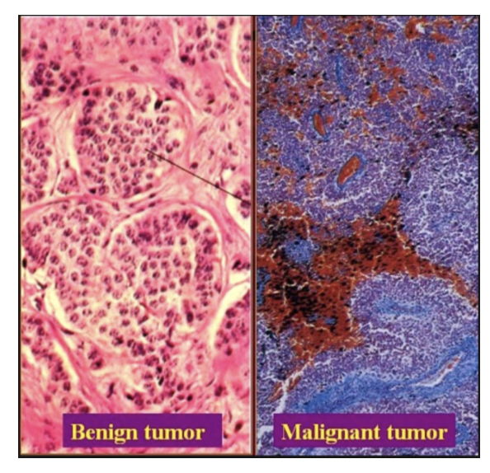
Linear Least Squares
Dataset containing the characteristics of cells for several patients. Can we make predictions if cells are benign or malignant?

Slide 44
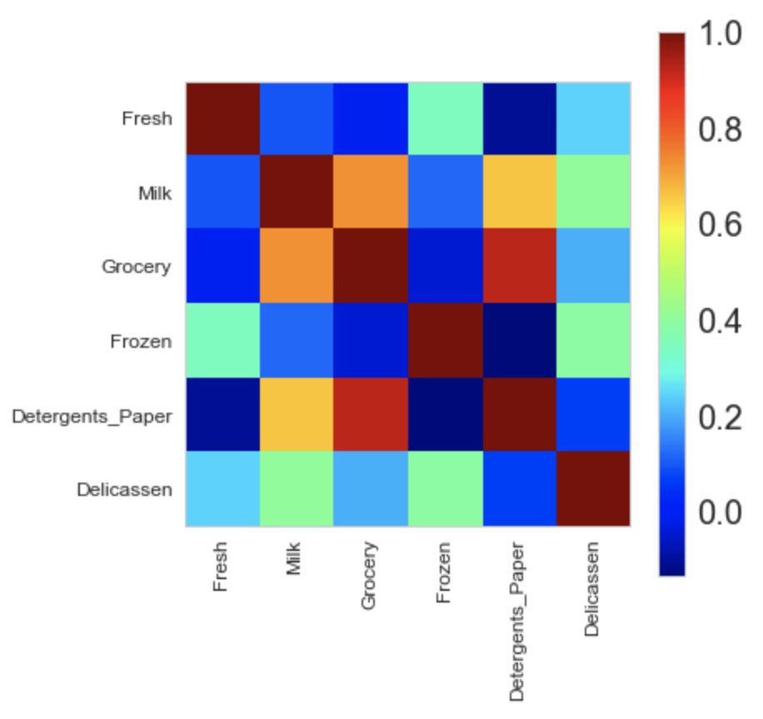
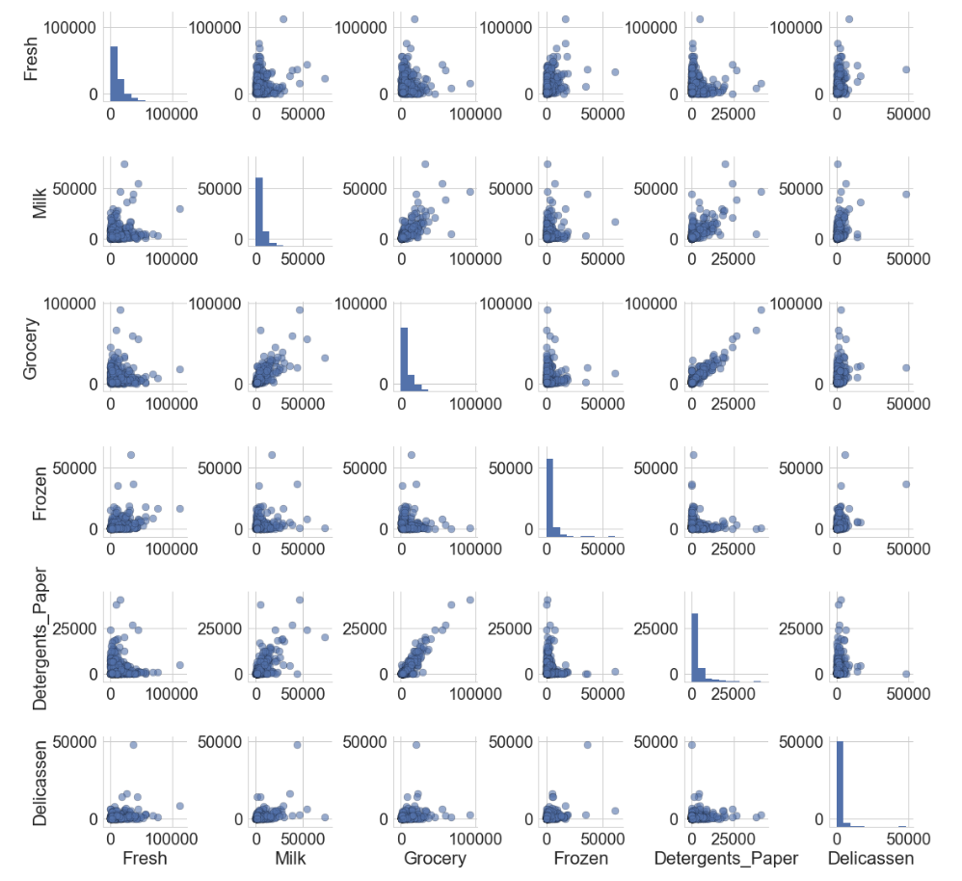
Principal component analysis
Sometimes our dataset has too many features? How can we reduce the feature space and still keep the most important information?

Slide 45
WEEKS 1:
Both Tuesday and Thursday:
Synchronous hybrid class for all students
Section N at CIF
Section M join on Zoom
STARTING FROM WEEK 2:
Tuesdays:
Group activity
Attendance required only for students in section N
Section M students optional support via Zoom
Thursday:
Optional Study Hours
Additional examples
All students who want to get this additional help should go to CIF
No Zoom option

Slide 46
Second day of classes…

Slide 47
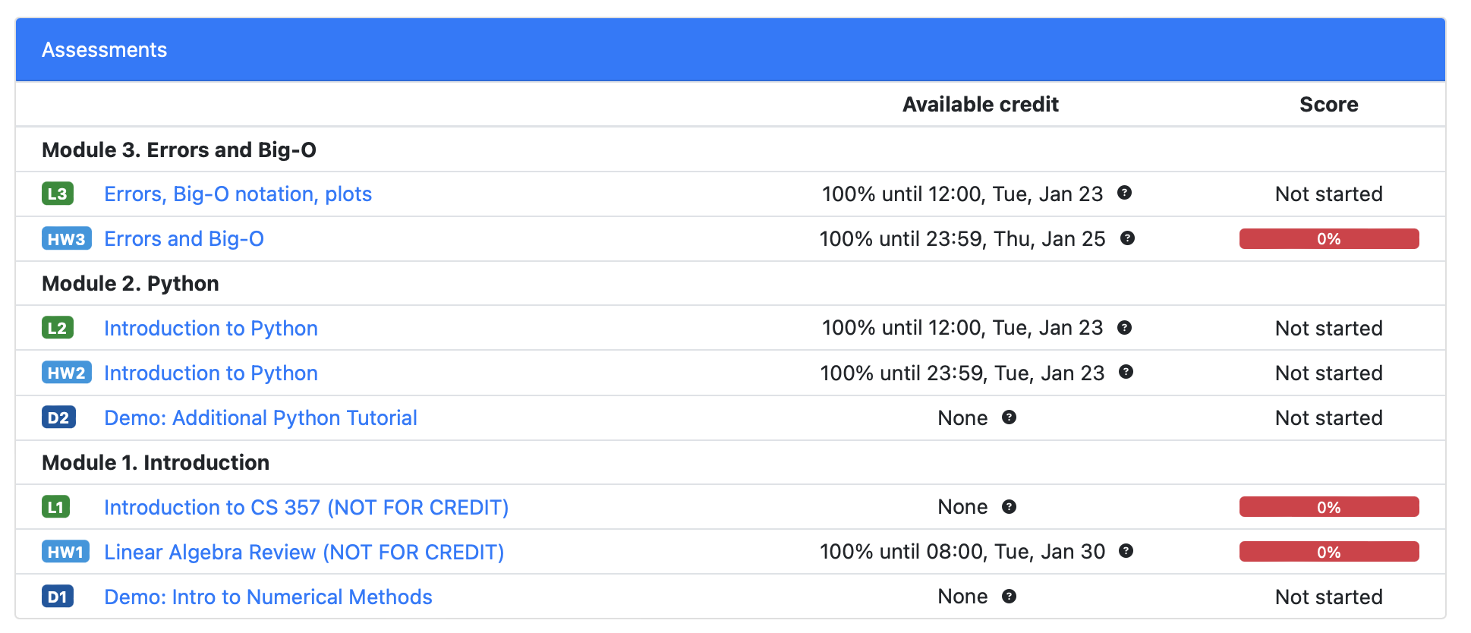
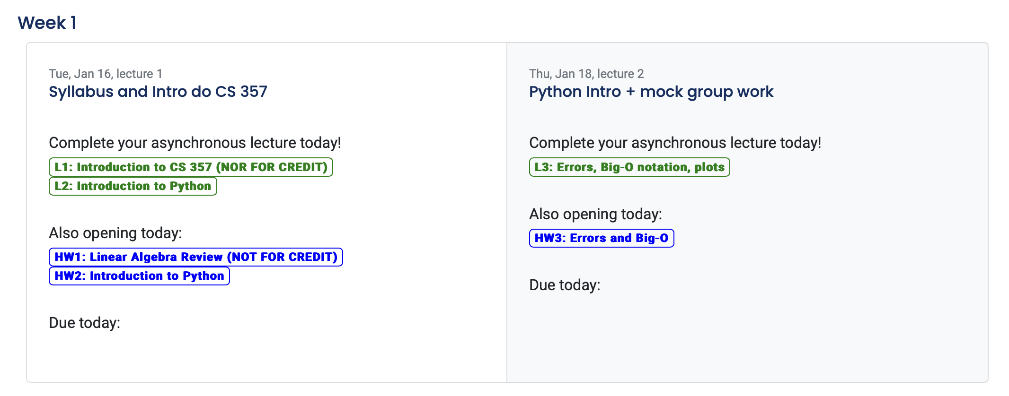

Slide 48
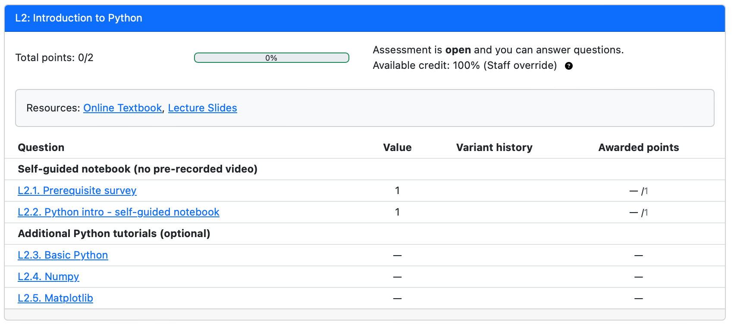
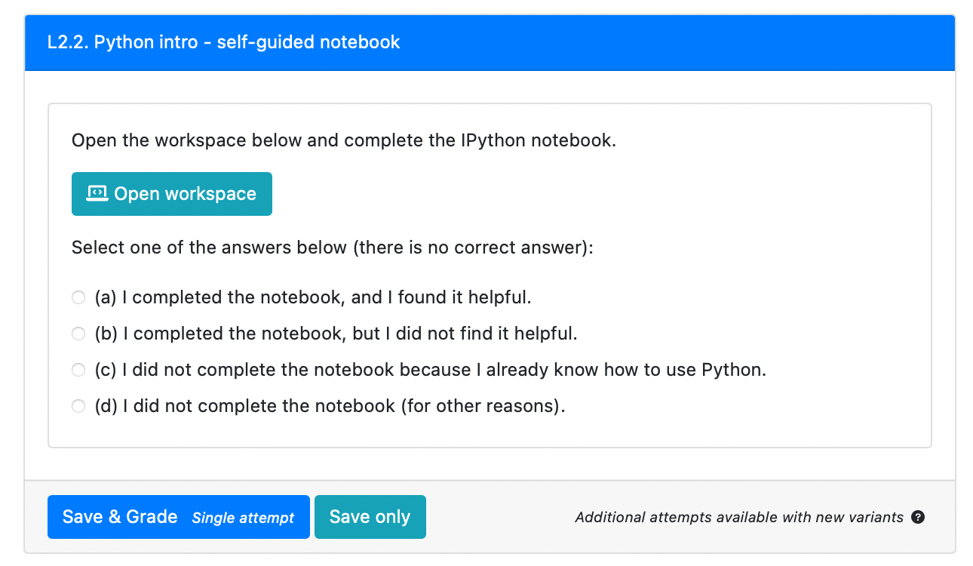
L2: Introduction to Python

Slide 49
Collaborative Learning
Collaborative learning has been shown to improve:
sense of belonging
learning outcomes
retention of knowledge
The benefits of collaboration can diminish:
effort distribution is inequitable
team members are stereotyped into specific roles (e.g., women expected to take notes)
The assignment of pre-defined roles can mitigate these issues

Slide 50
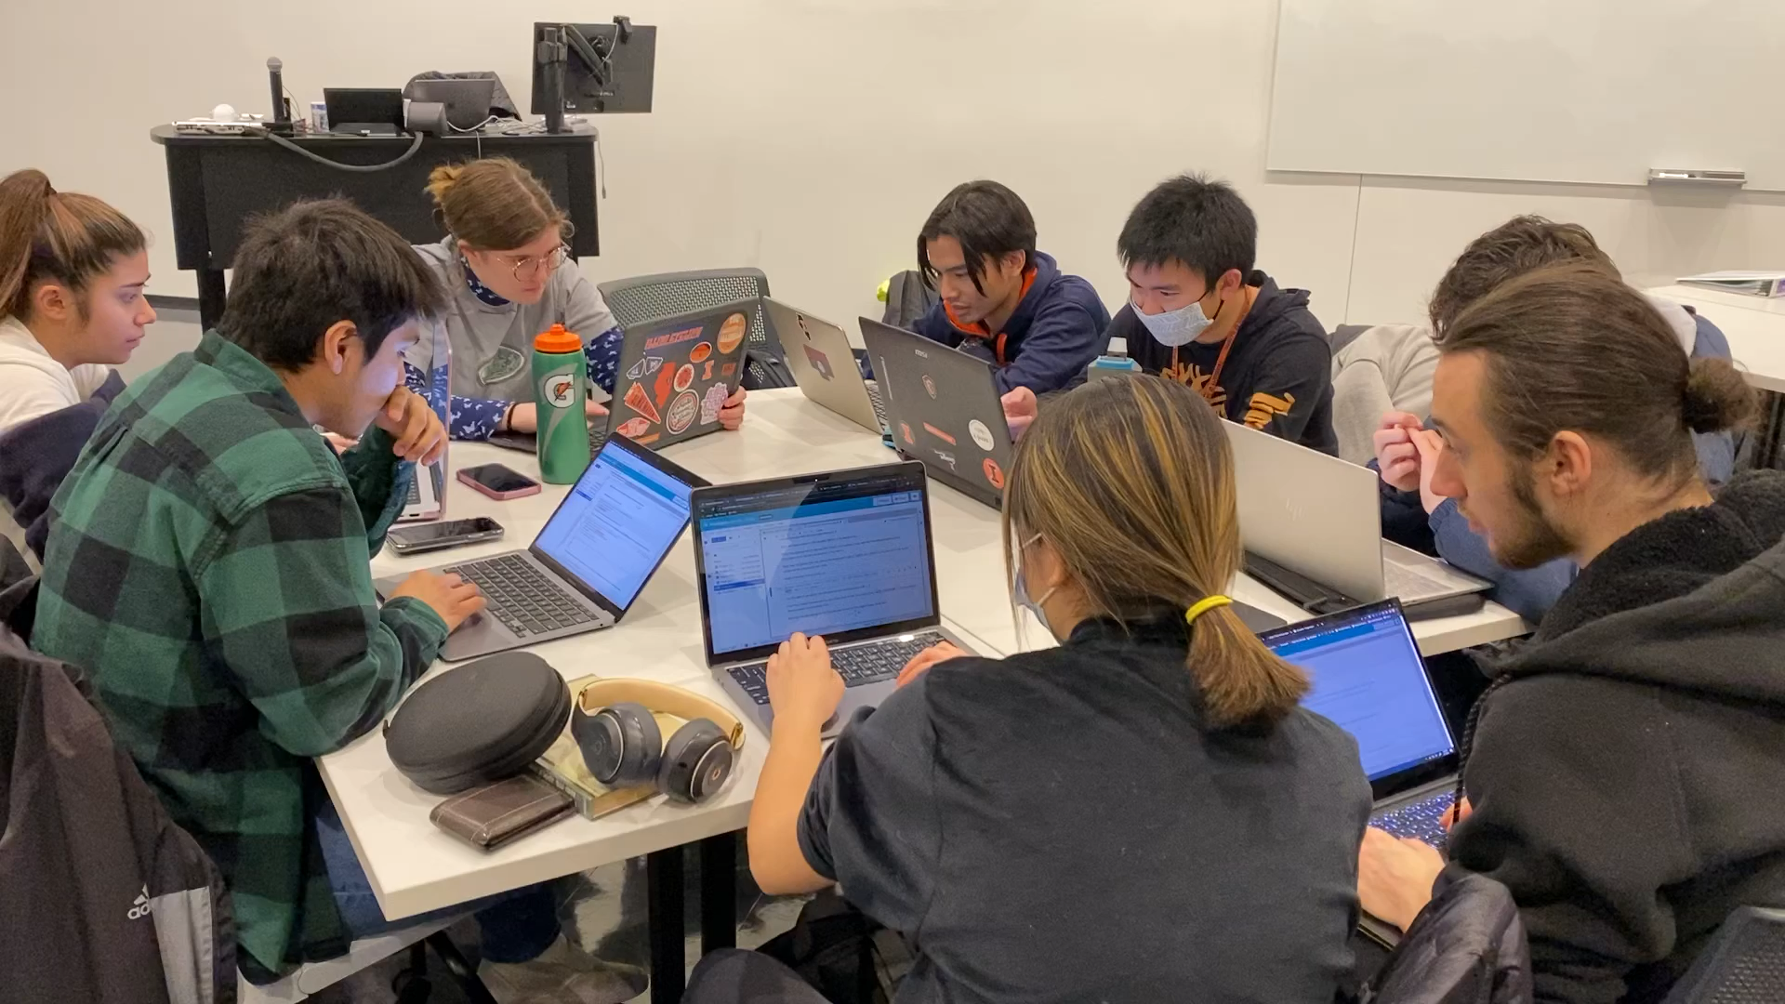
Supporting Collaborative Learning with Structured roles
Manager: keep team on task; enter the roles in PL
Recorder: enter most of the answers in PrairieLearn
Reflector: makes sure everyone is keeping up; complete survey
Consent was given for the media usage

Slide 51
Collaborative Learning
Complete weekly activity in groups
Week 1 and 2: randomly assigned groups via Zoom
Then you will have the option to form your group
Starting from week 3: fixed groups

Slide 52
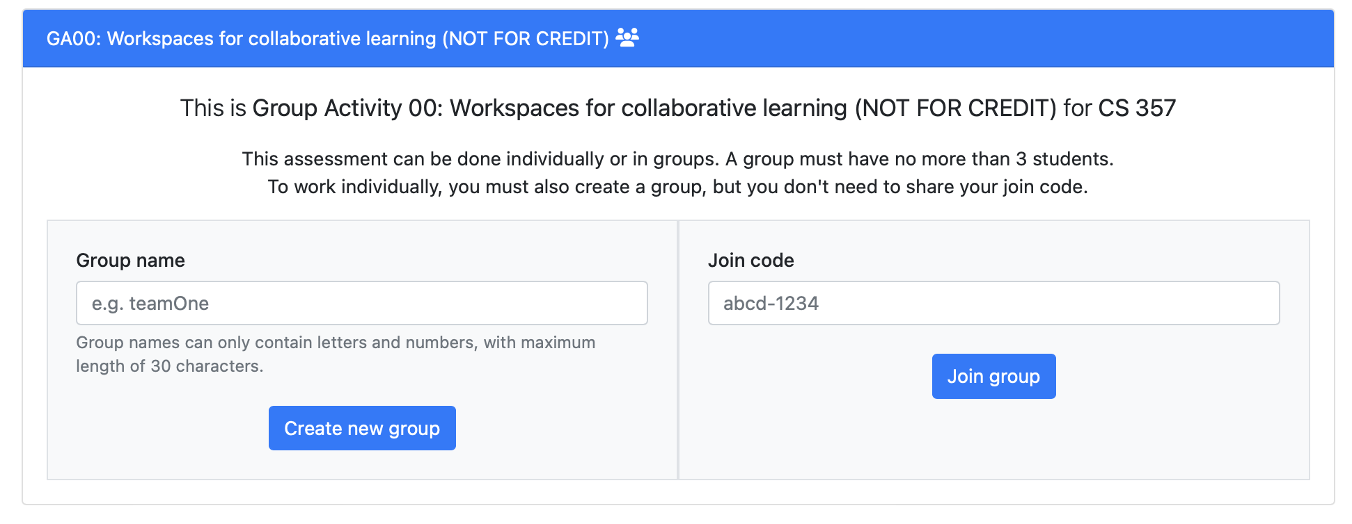
Creating a group assessment in PL
We will go over this first mock GA.

Slide 53
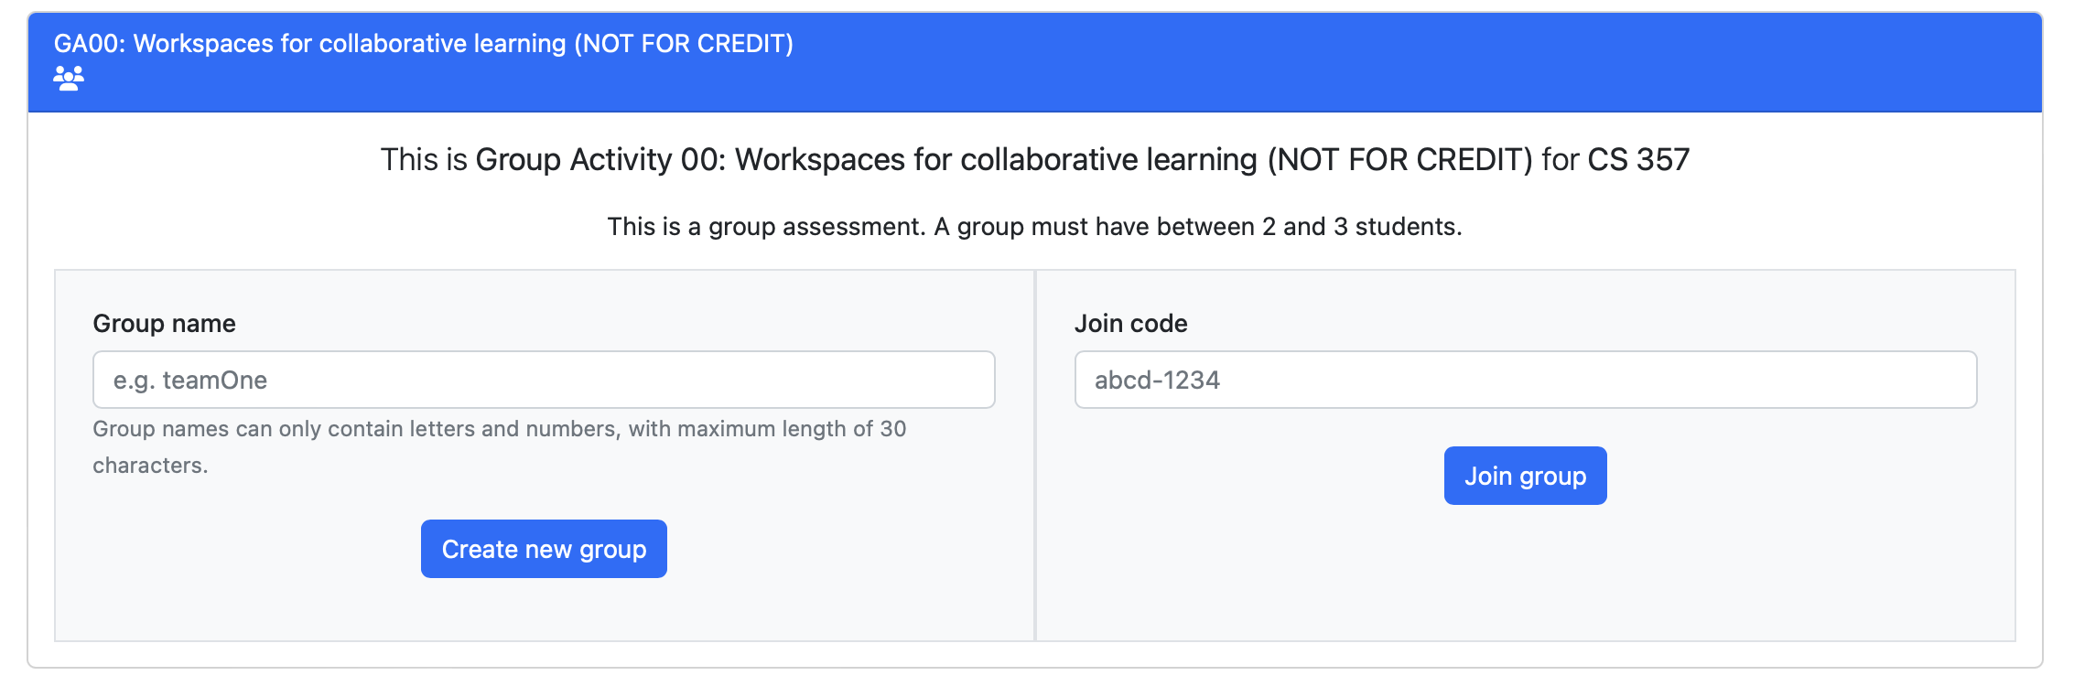
Creating a group assessment in PL

Slide 54
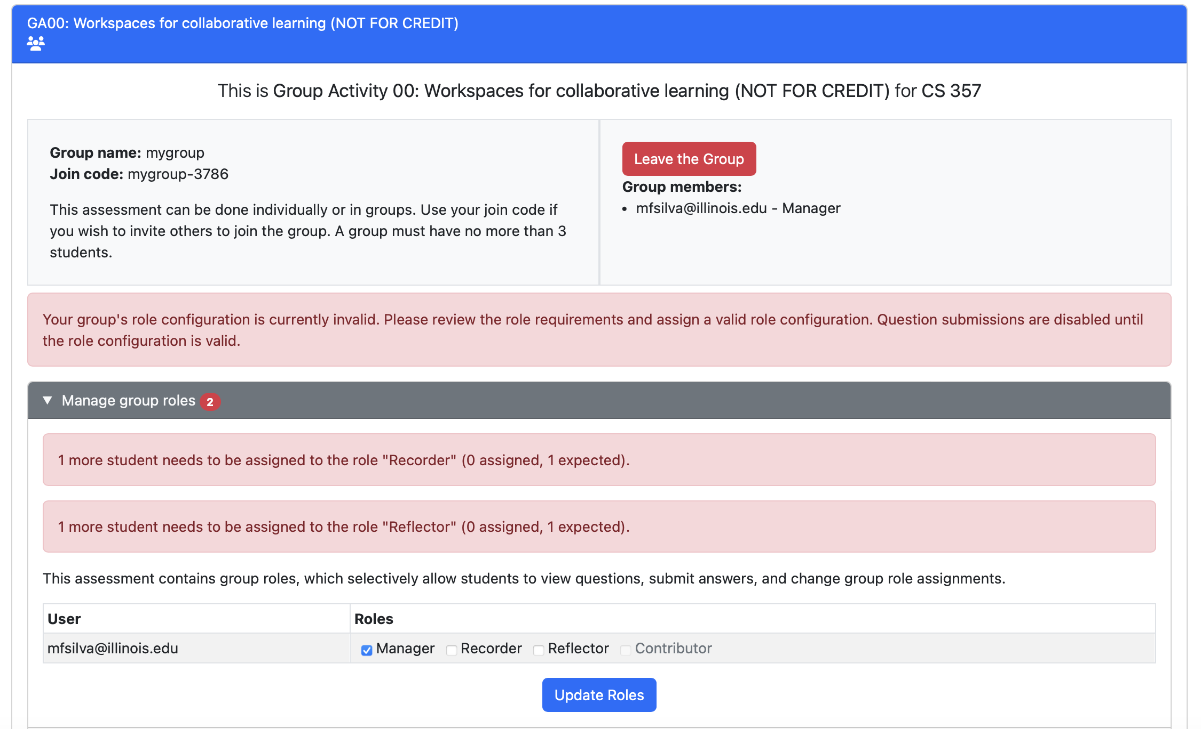
You will now complete this GA with a random group. We will give you 7 minutes.

Slide 55
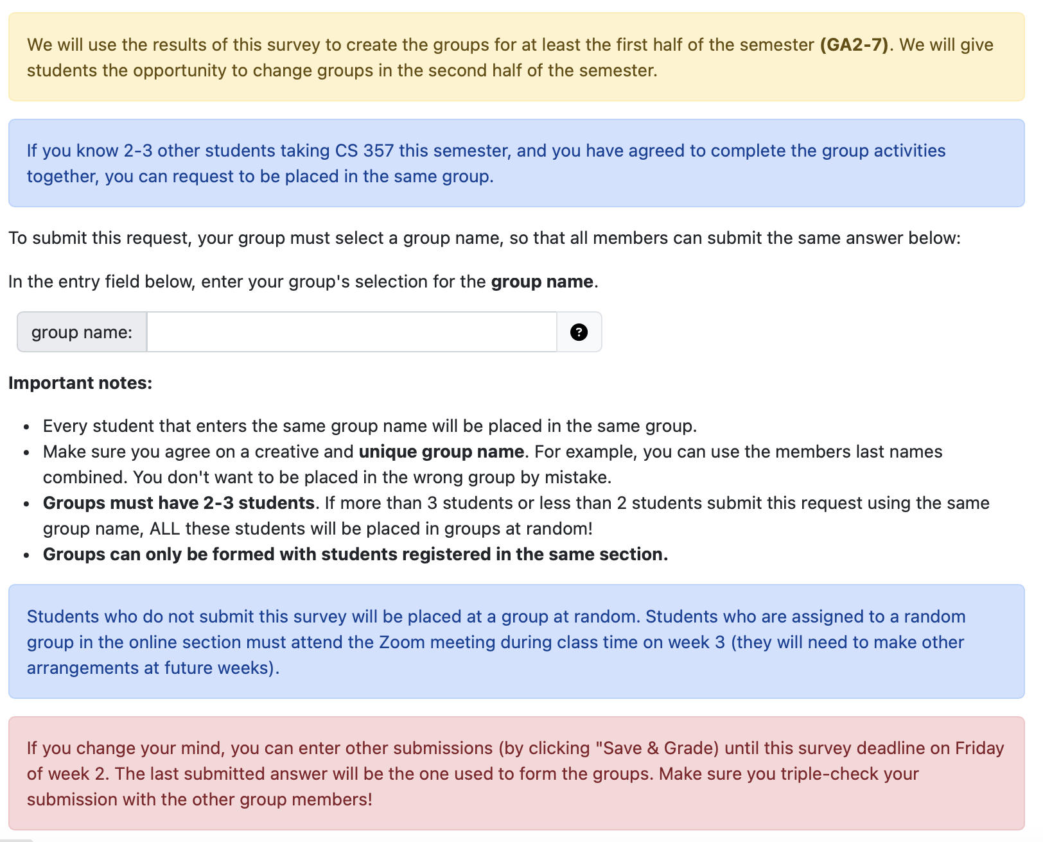
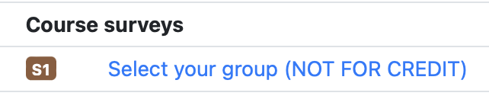
Creating the groups
Submit the survey by next Friday!
Students with time conflict override (not able to attend lecture) MUST find a team that agrees to meet at a different time.
Fixed groups start on week 3
Option to opt-out.

Slide 56
Completing the GAs (Section N)
Attendance at CIF 35 is required
We will use the QR code from your Illinois App)
You must not be late
Absences:
If you are ill, do not come to the classroom:
Make arrangements with your team to connect remotely
Submit a request for excused absence
DO NOT JOIN A GA IF YOU ARE NOT PARTICIPATING IN THE ACTIVITY (not in the classroom, or remote attendance due to illness). You will receive a zero in that GA.

Slide 57
Completing the GAs (Section M)
IF YOU PRE-SELECTED YOUR TEAM
Your team can agree on a time and location to meet
IF YOU WERE ASSIGNED TO A RANDOM TEAM
Your team must meet via Zoom during class time on week 3. You will need to make other arrangements for other weeks
TO GET SUPPORT
GA support offered 12:30pm to 1:45pm via Zoom
Queue must be used to request help
Only team members participating in the completion of the GA can use the Join code.

Slide 58
Peer Review Surveys
Peer reviews (twice in the semester): answer these statements about yourself and teammates
Makes high quality contribution to the team’s work
Asks for and shows an interest in teammates’ ideas and contributions
Demonstrates knowledge of course content or actively asks questions when lost or confused
Motivates the team to do excellent work
I would gladly work with this individual in the future
Peer reviews are optional (but highly encouraged) for in-person section and required for online section.

Slide 59
How the final GA score is computed
In general: 9% correctness and 2% attendance/participation
Section N (in-person)
Attendance = 1 if attended class; 0.82 if did not attend
GAi-Grade (Canvas) = GAi-PL-Grade * Attendance
(all GAs i=2-13 are computed using this rule + drop of lowest score)
Section M (online)
GAi-Grade (Canvas) = GAi-PL-Grade (for i = 2-12 except for i=7)
PeerSurvey1 and PeerSurvey2 = 0 or 1 (1 if completed)
GA7-Grade (Canvas) = GA7-PL-Grade * PeerSurvey1
GA13-Grade (Canvas) = GA13-PL-Grade * PeerSurvey2
Opt-out option (online only)
GAi-Grade (Canvas) = GAi-PL-Grade * 0.82

Slide 60
Summary: Difference between Sections M and N
Section N (in-person) | Section M (online)
Attendance is required | Attendance not required. Option to opt-out.
Start GA during class time. Most groups will complete GA before the end of the class. Can still complete GA until 10pm | Can start GA at any time from 12:30pm and complete by 10pm.
Support during class time at CIF 35. We will have 7 course staff at CIF. | Support during class time via Zoom. We will have 7 course staff on Zoom duty.
A student can request remote attendance in case of sickness. The remote arrangements should be decided by the group. Remote attendance will be verified by course staff during class time. | Students can make arrangements for remote attendance when someone is sick without communication with course staff (in case a group meets in-person)

Slide 61
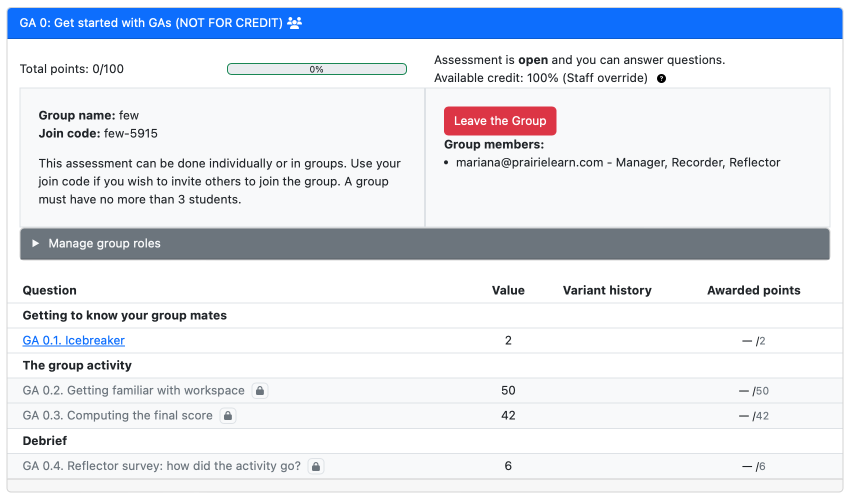
Practice Group Activity

